Slide 1





Codebasics Internship
By: AtliQ Technologies
Wavecon
Dashboard Analysis
By: Mohd Sofiyan

Slide 2

Introduction
Welcome to Wavecon, a leading player in the telecommunications industry known for its stellar service.
We're thrilled to announce the launch of our highly anticipated 5G service, marking a significant milestone in our product lineup.
As we delve into this exciting chapter, we're keen to swiftly evaluate the success of the 5G rollout, with a focus on metrics like customer acquisition and service speed.
Additionally, we're eager to track the performance of our different 5G plans since their introduction.
Wavecon
Dashboard Analysis
By: Mohd Sofiyan

Slide 3
Objectives
1. Top performance cities
2. bottom performance cities
3. Market share
Wavecon
Dashboard Analysis
Market
Insights
1. Revenue
2. Arpu
Average revenue / user
Top performing plan after 5g.
3. TAU
4. TUsU
Total active user
Total unsubscribe user
2. Top performing cities
3. Least performing plans
Kpi Performance
Subscription
Plan insights
By: Mohd Sofiyan

Slide 4
Market
As we can see the revenue has decreased but not significantly and the city is like Mumbai, Delhi, and Kolkata they are showing progress interesting fact if we see the cities like Lucknow, Patna, and Raipur which all growing cities we can see the revenue has increased soon in those cities after 5G
Revenue By Cities
and the cities which are the tech cities like Pune, Mumbai, and Bangalore they have also shown a prominent growth in their avenue so there the impact after the 5 launch is positive.
Tech Cities
And if you see the revenue by month, we can see later revenue for greasing from Jan to Feb then it will become a plateau got a plateau and but the difference between before and after 5G revenue has been same and they are not a big changes that's a positive sign because the 5G benefit is after one and now people are understanding that and they are going for 5G scheme as well as 5G cell Phones.
Revenue Trend
By: Mohd Sofiyan

Slide 5

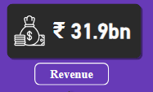
Overview of revenue kpi
Revenue
Wavecon has achieved a substantial revenue figure of 31.9 billion, which underscores the company's robust financial performance and market presence.
By: Mohd Sofiyan

Slide 6
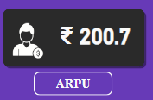
Overview of ARPU kpi
ARPU(Average Revenue Per User)
The ARPU stands at 200.7, indicating the average income Wavecon generates per user.
By: Mohd Sofiyan

Slide 7
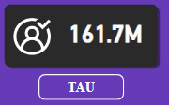
Overview of tAU kpi
TAU(Total Active Users)
With 161.7 million active users, Wavecon demonstrates a strong customer base.
By: Mohd Sofiyan

Slide 8
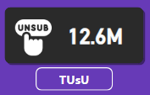
Overview of TUSU kpi
TUsU(Total Unsubscribed Users)
The total unsubscribed users count at 12.6 million offers a glimpse into customer churn.
By: Mohd Sofiyan

Slide 9
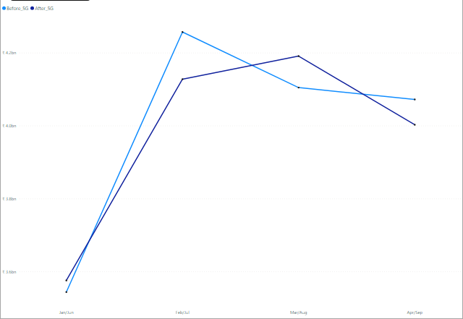
Revenue insights
Before 5G
After 5G
The total revenue after the 5G launch is reported as 15.9bn compared to 16.0bn before 5G, indicating a slight decrease of 0.50%.
Apr/Sep accounted for 27.46% of Before 5G Launch.
Cities like Mumbai and Jaipur have shown an increase in revenue post-5G, with changes of +0.31% and +0.98% respectively.
This could imply that customers are gradually transitioning to 5G or that the impact of 5G has not yet fully materialized in the revenue numbers.
By: Mohd Sofiyan

Slide 10
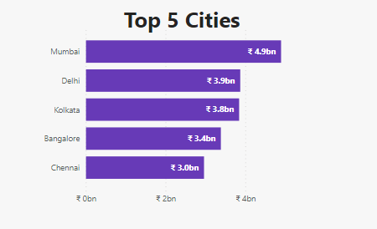
Top 5 cities by revenue
Mumbai, Delhi, Kolkata, Bangalore, and Chennai are the top five cities generating the highest revenue.
This indicates a strong market presence and suggests these cities have effectively adapted to or embraced the 5G launch.
By: Mohd Sofiyan

Slide 11
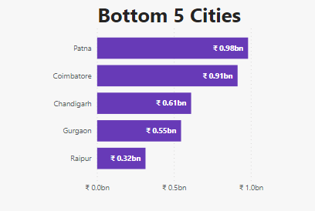
Bottom 5 cities by revenue
Pune, Coimbatore, Chandigarh, Gurgaon, and Raipur show the lowest revenue figures among the listed cities.
Targeted strategies such as localized marketing campaigns or special promotions could be beneficial in these areas to boost revenue.
By: Mohd Sofiyan

Slide 12
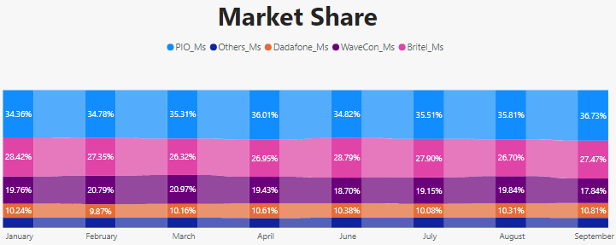
insights
Market share
Wavecon's market share shows a slight decline from earlier months to September.
Starting strong at 10.24% in January, there is a peak around June at 10.31%, followed by a decrease to 10.18% in September.
This suggests that Wavecon might be facing increased competition or losing ground to other providers.
After the 5G Launch, the market share declined to 18.70% in June from 20.97% in March and further declined to 17.84% in September.
By: Mohd Sofiyan

Slide 13
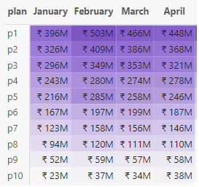
Well Performing Plans
Subscription plans
Plan p1 (Smart Recharge Pack): The revenue increased from 1.8bn to 2.4bn post-5G.
Plan p2 (Super Savior Pack): The revenue stayed consistent at 1.5bn post-5G.
Plan p3 (Elite Saver Pack): The revenue remained stable at 1.3bn post-5G.
Plans p1, p2, and p3 appear to be well-positioned to leverage the benefits of 5G, and efforts should be focused on promoting these plans.
By: Mohd Sofiyan

Slide 14
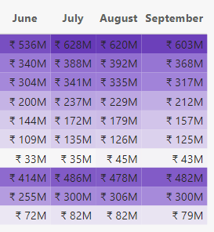
poor Performance Plans
Subscription plans
Plan p4 (Mini Data Saver Pack): The revenue dropped from 1.1bn to 876.8M post-5G.
Plan p5 (Rs. 99 Full Talk-time Combo Pack): There was a significant revenue decline from 1.0bn to 651.5M post-5G.
Plan p6 (X-stream Mobile Data Pack): The revenue decreased from 749.1M to 494.6M post-5G.
Plan - p7 experienced a major decrease in revenue, dropping from 146M to 43M.
The company discontinued plans p8,p9,p10 with the introduction of new plans p11, p12 and p13.
By: Mohd Sofiyan

Slide 15
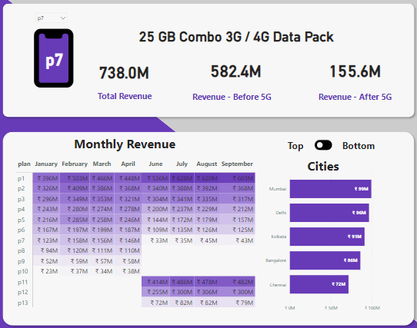
25gb combo 3g/4g data pack (Plan P7)
Which plan is under performing after 5g launch
There is a substantial decrease in total revenue from 738.0M before 5G to 155.6M after 5G.
The monthly revenues post-5G launch are significantly lower compared to the months leading up to the launch, suggesting a correlation between the introduction of 5G and the plan's declining sales.
Mumbai contributes an additional 99M, making it the top city for this plan, followed by Delhi at 96M, and Kolkata at 91M.
Bottom cities like Chennai show contributions as low as 72M.
This geographical revenue distribution can inform targeted marketing strategies.
By: Mohd Sofiyan

Slide 16
Conclusion
Codebasics Internship
By: AtliQ Technologies
In conclusion, the Wavecon Dashboard Analysis offers valuable insights into performance optimization. By leveraging KPIs, data visualization, optimization strategies, and user experience enhancements, organizations can elevate their decision-making capabilities and drive sustainable growth.
By: Mohd Sofiyan

Slide 17
Thanks!
Codebasics Internship
By: AtliQ Technologies
Do you have any questions?
sofiyan4us@gmail.com
+91 8886768482
LinkedIn
Portfolio
Wavecon
Dashboard Analysis
By: Mohd Sofiyan

